Slide 1
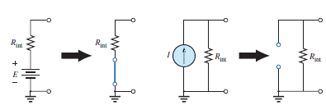
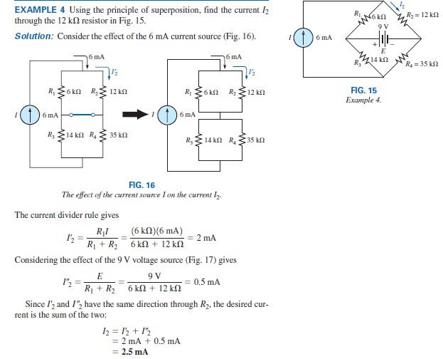
College of Engineering Dept. of the electrical power and Machine engineering
Subject / Electrical Eng. Fundamental I
stage / first Date: 19/12/2017 Lecture:8
Time/ 2 hours
SUPERPOSITION THEOREM
Analyze networks that have two or more sources that are not in series or parallel.
Reveal the effect of each source on a particular quantity of interest.
For sources of different types (such as dc and ac, which affect the parameters of the network in a different manner) and apply a separate analysis for each type, with the total result simply the algebraic sum of the results.
when removing a voltage source from a network schematic, replace it with a direct connection (short circuit) of zero ohms. Any internal resistance associated with the source must remain in the network.
when removing a current source from a network schematic, replace it by an open circuit of infinite ohms. Any internal resistance associated with the source must remain in the network.

Slide 2
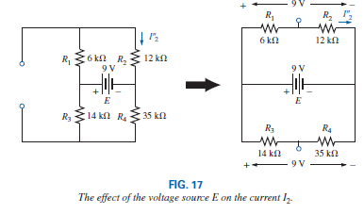
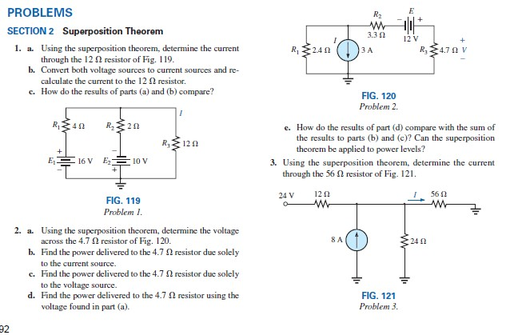
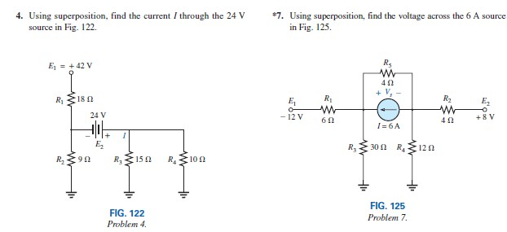
College of Engineering Dept. of the electrical power and Machine engineering
Subject / Electrical Eng. Fundamental I
stage / first Date: 19/12/2017 Lecture:8
Time/ 2 hours

Slide 3
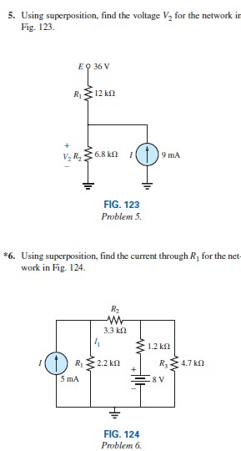
College of Engineering Dept. of the electrical power and Machine engineering
Subject / Electrical Eng. Fundamental I
stage / first Date: 19/12/2017 Lecture:8
Time/ 2 hours

